Slide 1
Design, Develop, Implement & Document Community Portal Website
Module Project
Module: Web Development Foundations
Course: NICF Advanced Certificate in Software & Applications (Development & Deployment)
Start Date : 6 February 2023
End Date : 06 March 2023
Submission Date : 06 March 2023
Learner Name : Agung Yuda Pratama
Enrollment ID : BDSE07-0922-076
Presentation Date :

Slide 2
Contents
Document History
Version Number | Effective Date of release | Summary of Included Changes | Author
1 | 4th March 2016 | First Edition | Satya CVS
2 | 08th Sep 2017 | Changed for Module 5 | Shrinivas K R
3 | 20th Jul 2018 | Changed for Module 5 RQF | Shrinivas K R

Slide 3
Contents
Contents
S. No. | Description
01 | Development Tools
02 | Business Process
03 | Application Block Diagram
04 | Applications
05 | Models, Controllers & Classes Developed
06 | UI Design
07 | Includes
08 | Software Development Methodology
09 | Project Plan
10 | Application Screen Shots
11 | Project Milestones & Tasks
12 | Milestone Feedback & Action Taken
13 | Modifications Made On Feedback
14 | Project Results
15 | Proposed Improvements

Slide 4
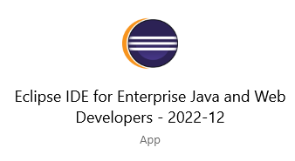

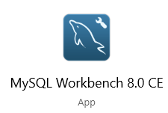
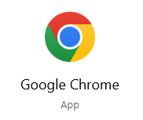
1. Development Tools
Development Tools Screen captures
Eclipse
MySQL Workbench
Apache Tomcat 9
Chrome

Slide 5
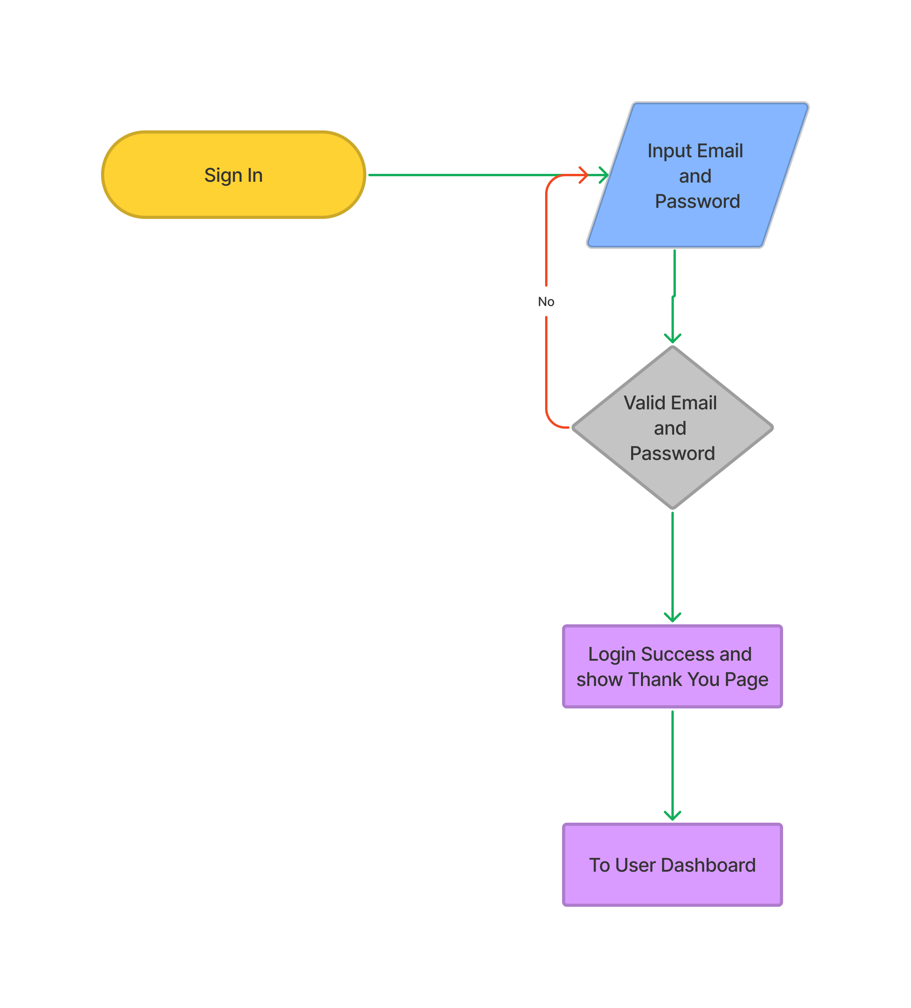
2. Business Process
Login Scenario
User goes to the Sign in Page. User must enter the email and the password that has been made. The system will check the data after the user clicks a sign-in button if the valid user continues. If false or different user will re-enter the email and password again. Next, Thank you page will show,and there is a button to continue to User Dashboard.

Slide 6
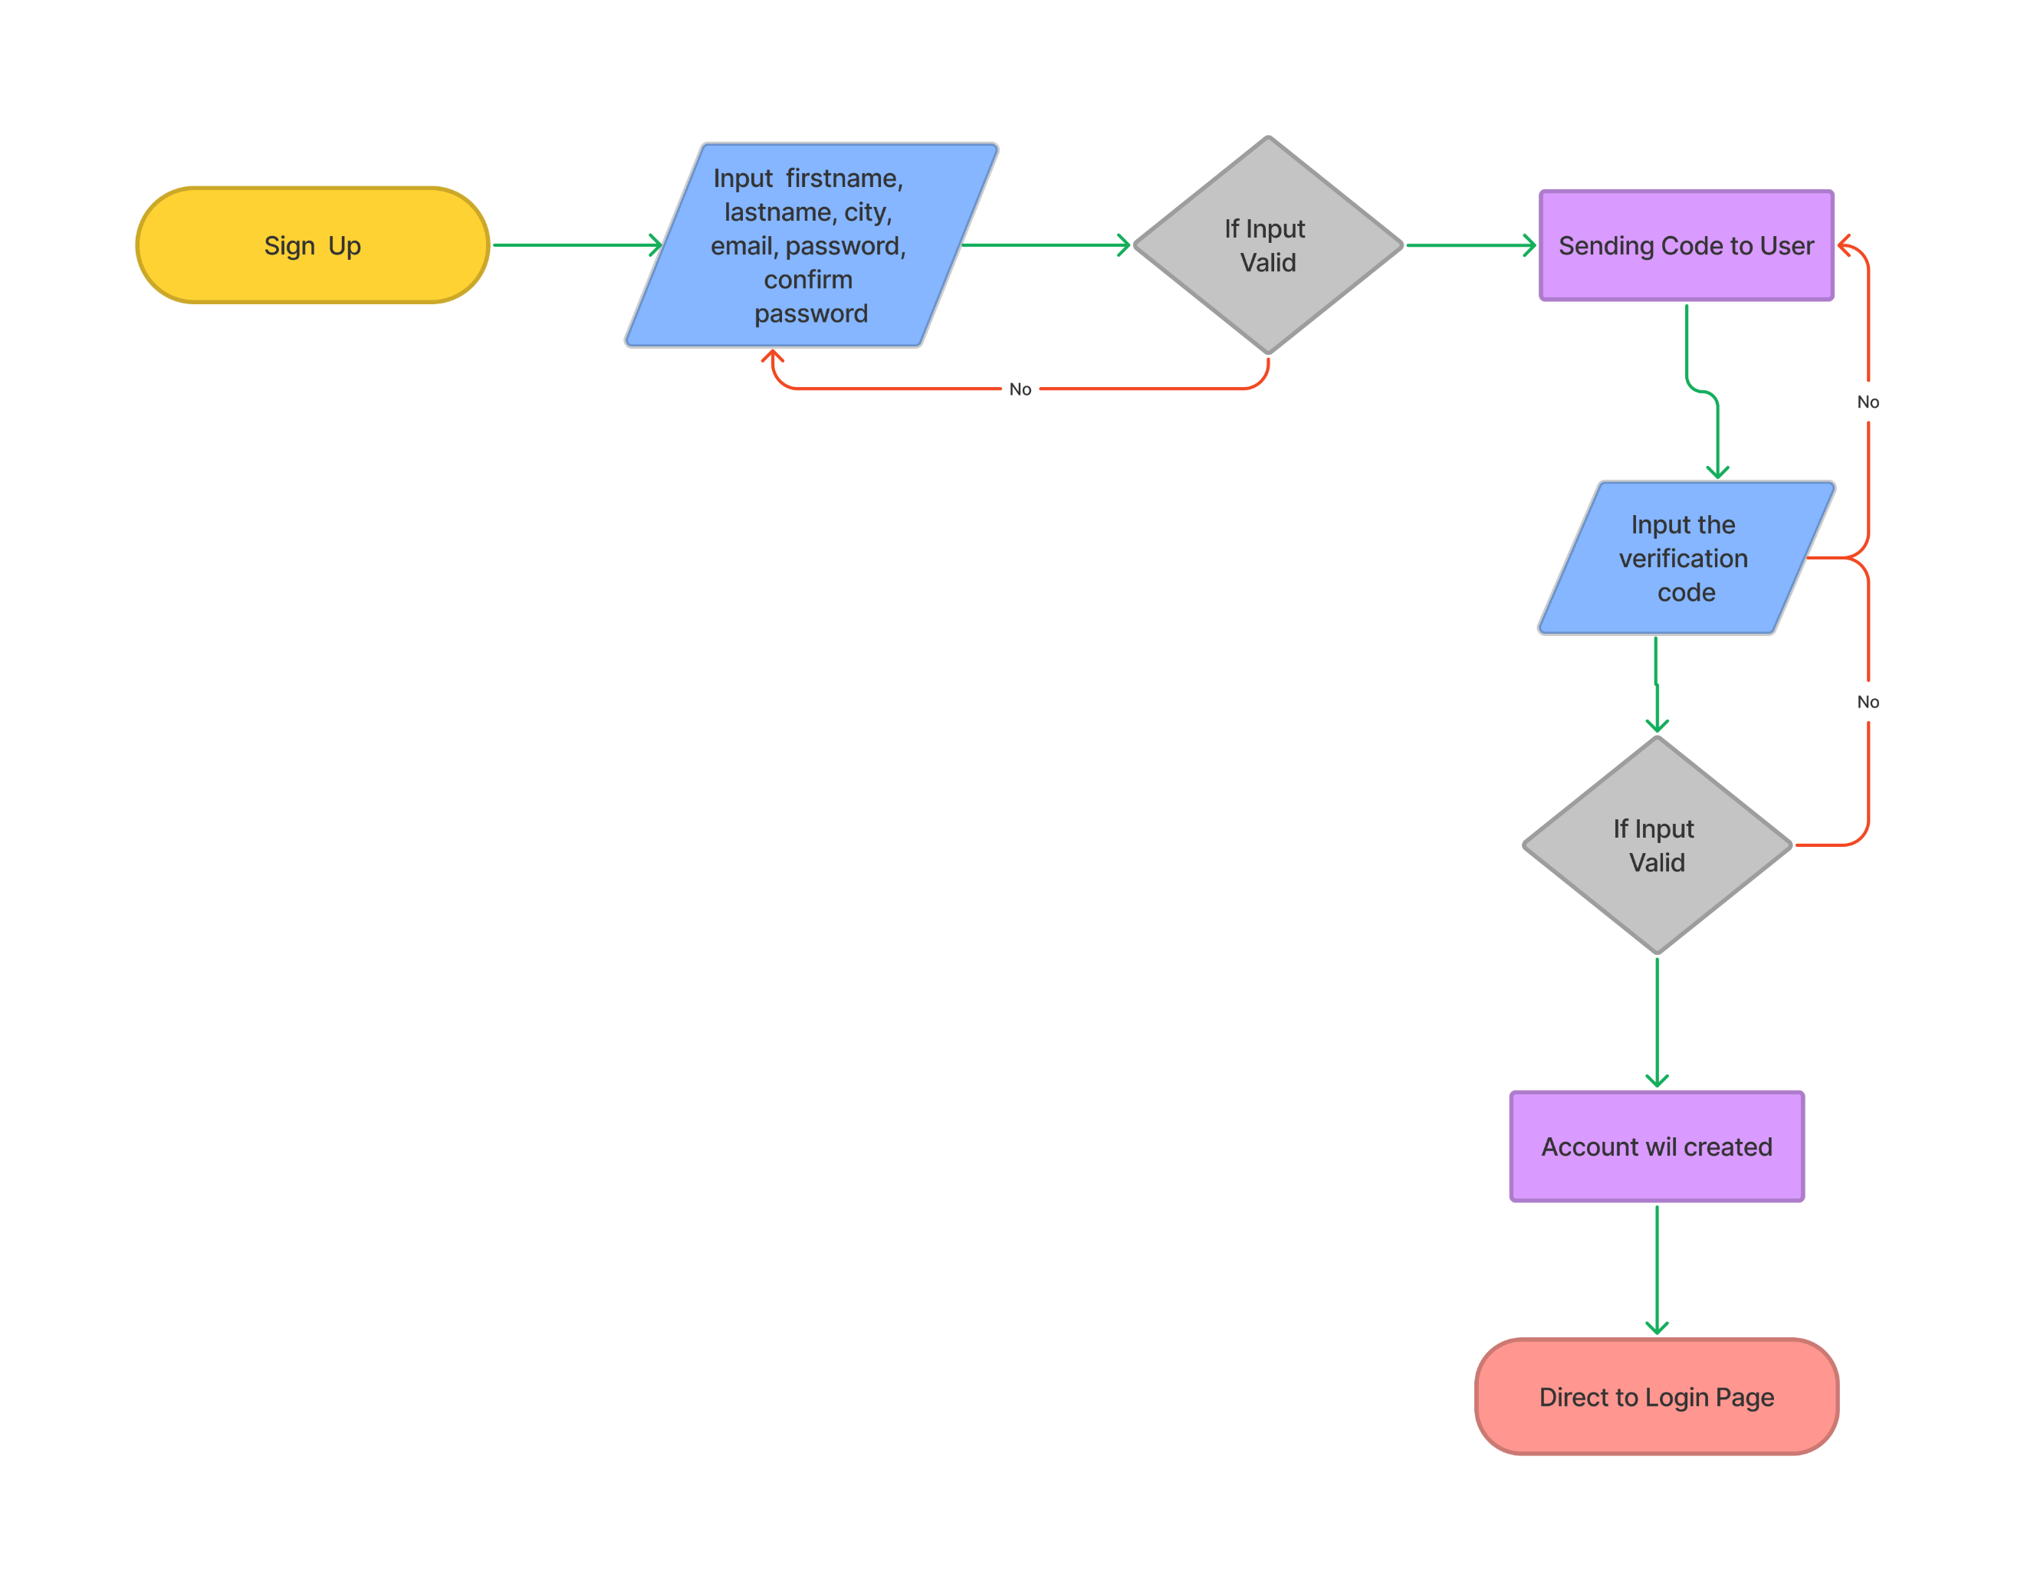
2. Business Process
Register Scenario
1. User at the sign-up page. 2. User enters their first name,last name, city, email, and password, confirms the password, and clicks sign up. 3. The user will see an error state above the button if entries are invalid. 4. If valid, a verification code will be sent on the next page. 5. If the user did not get the code, the user might click the resend button. 6. User inputs the verification code. 7. When clicking Create Your Account, the user will direct to create a profile 8. The page will direct to the login page.

Slide 7
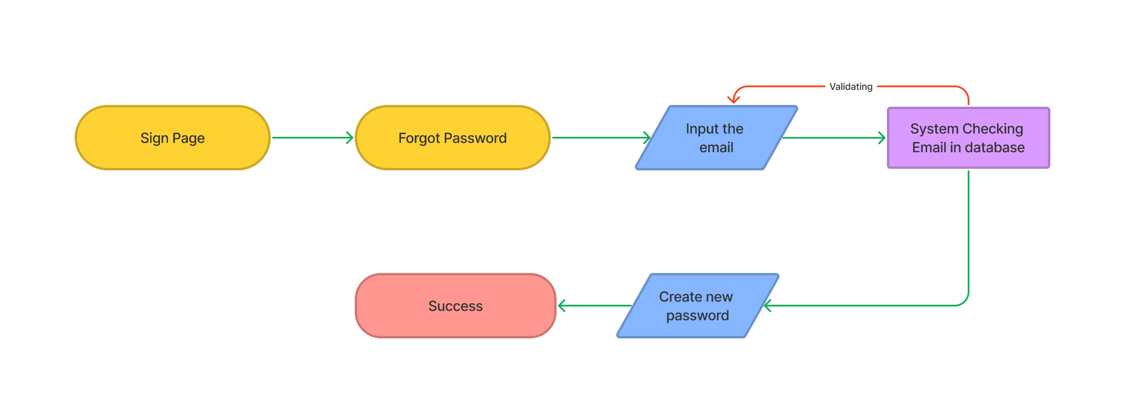
2. Business Process
Forgot Password Scenario
1. User at the sign-in page and click the forgot password 2. User enters the email that is used for sign in 3. If the email in database the process will continue, if not will show the alert 4. User enters a new password and confirms the password 5. When success directed to sign in page

Slide 8
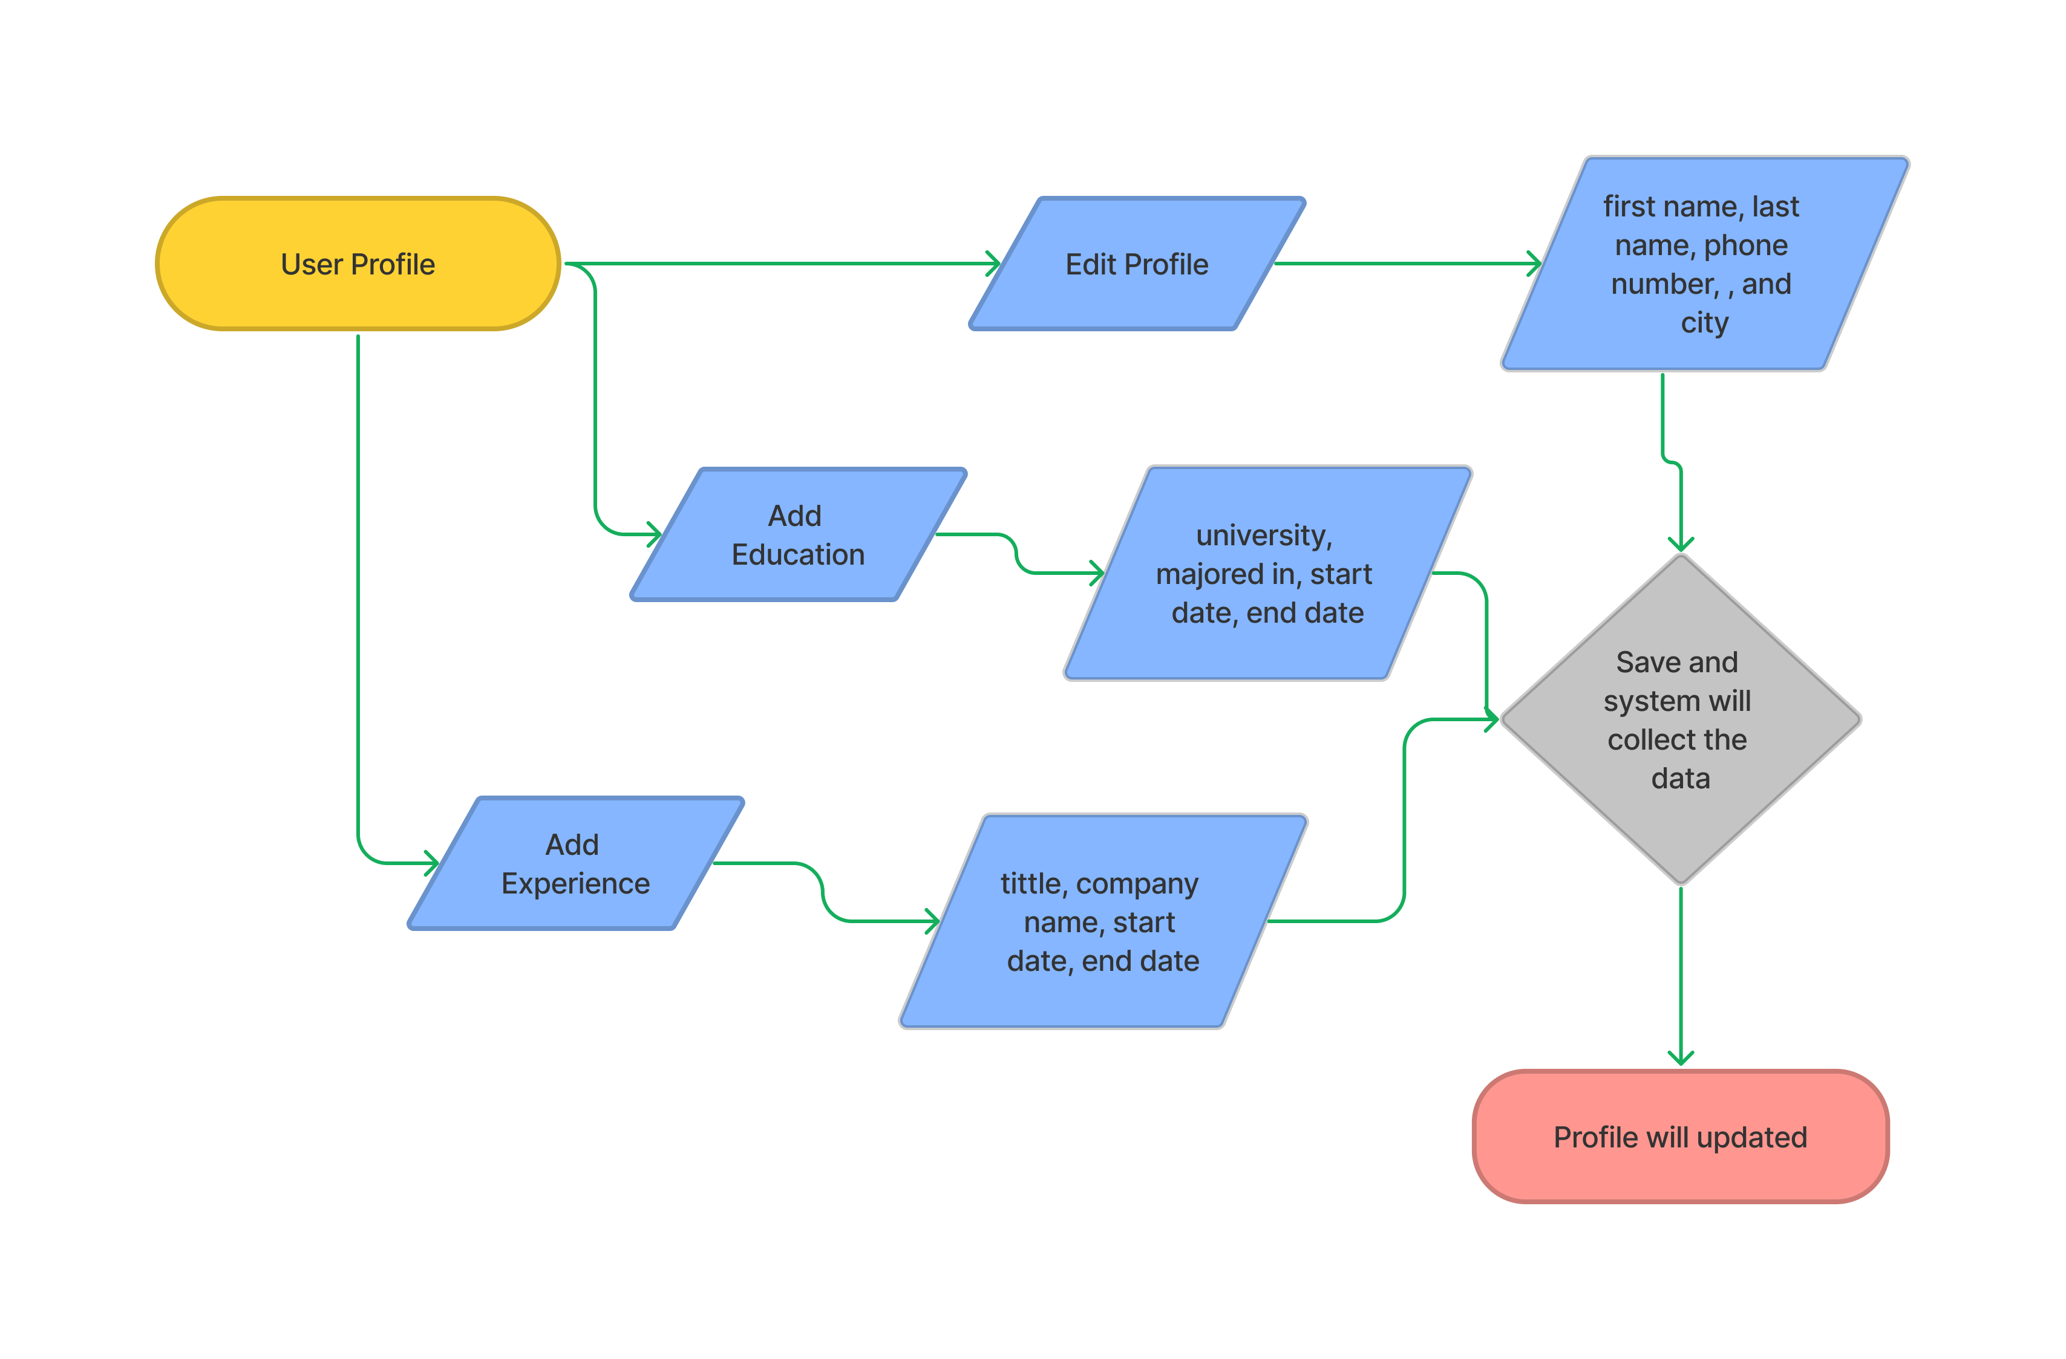
2. Business Process
Update Profile Scenario
Go to the user profile Click edit profile We can change the first name, last name, phone number, , and city. Also, have another option for editing the education and experience After we complete editing the profile, we can click save System will collect and update the data

Slide 9
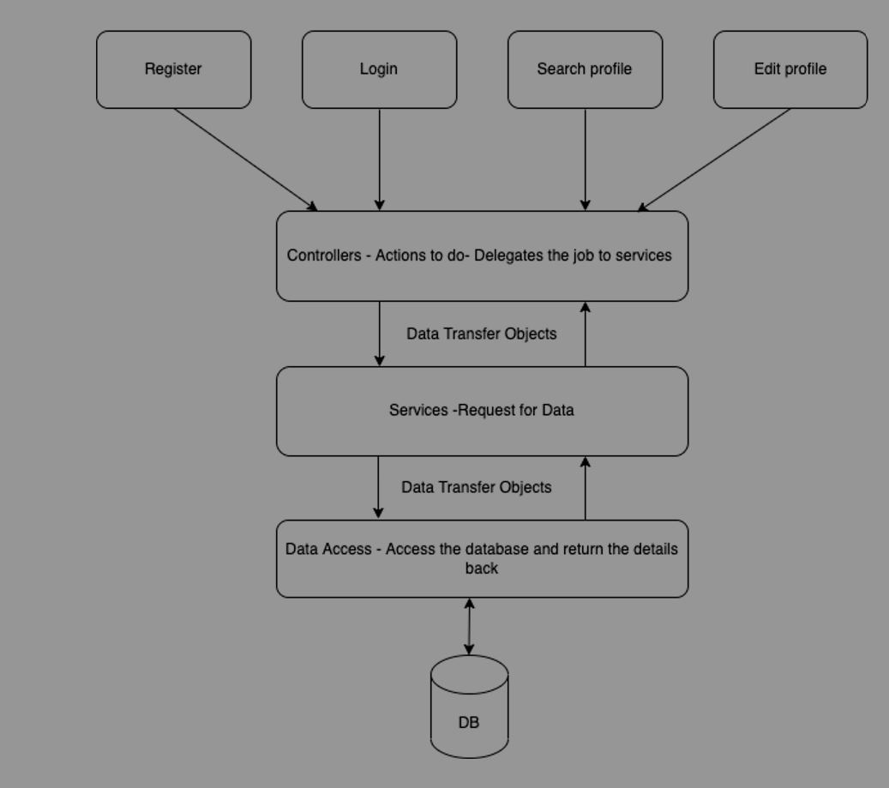
3. Application Block Diagram
Block Diagram of the Over all Application
Explanation :
The front controller, which is a servlet called DispatcherServlet, will initially handle each request that comes from the user and then dispatch it to the appropriate controller. The controller will respond in accordance with the nature of the request; for example, if the controller needs data from the database, it must connect to the service in order for the latter to contact the database and return a response to the controller.

Slide 10
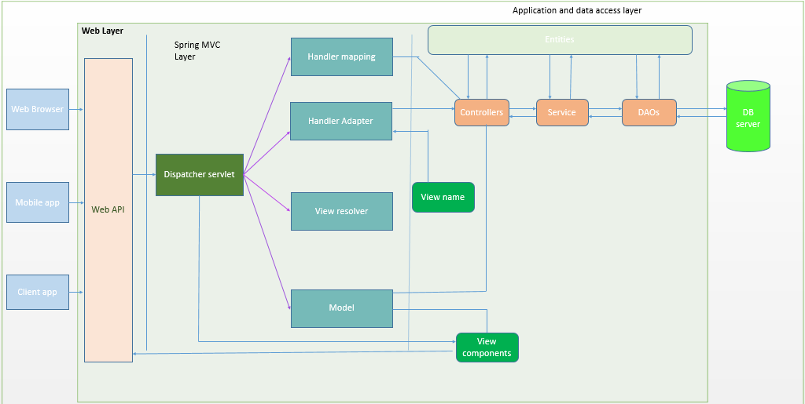

Slide 11
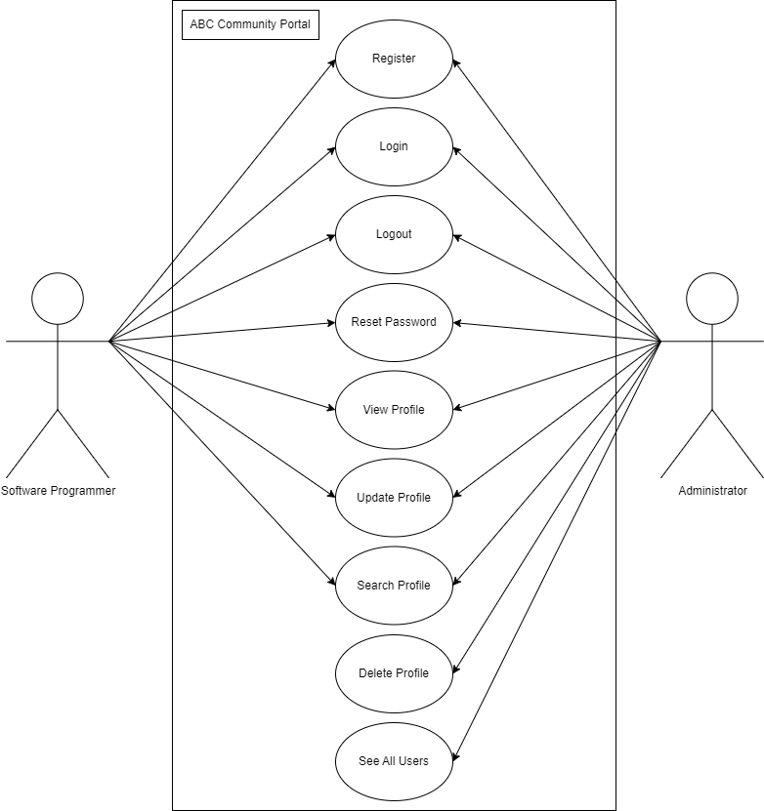

Slide 12
4. Applications
Description of Applications being Developed:-
Private module
Manage User
Bulk Emailing
Public module
Registration
Login
Forgot Password
Search and result
Viewing other profiles

Slide 13
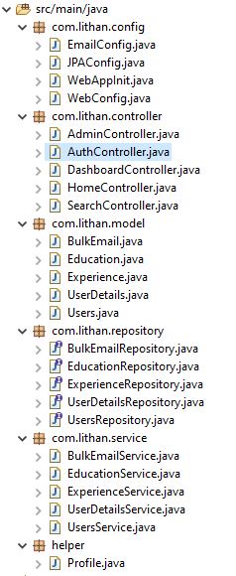
5. Models, Controllers, Classes Developed
Overview of Models, Controllers & Any Classes Developed
Controllers & Any Classes Developed

Slide 14
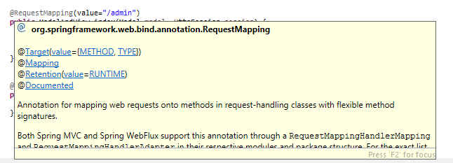
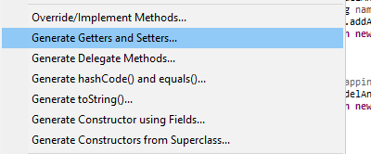


6. Tool Screens- Eclipse
Give Us Information when we point the cursor into a code that we dont understand
Has automatic Source Generator
Can Fix Errors by suggestion

Slide 15
7. Classes - Entities
Entities
S. No. | Class Name | Description
1 | User.java | Used to store user account credentials, including email and password information.
2 | UserDetails.java | Keep records of user information such first and last names, city, etc.a database for user skill data.
3. | Education.java | Save details on a user's educational history, including their major, university, year.
4 | Experience.java | Save details on a user’s experience history, company name, title, year.
5 | Bulk Email | Store data regarding Bulk Email

Slide 16
8. Classes Developed
Business Classes
S. No. | Class Name | Description
1 | UsersService.java | This service will connect Controller to UsersRepository
2 | UsersRepository.java | This Repository will connect the program to users table
3 | UserDetailsService.java | This service will connect Controller to UserDetailsRepository
4 | UserDetailsRepository.java | This Repository will connect the program to users details table
5 | AuthController.java | This controller will handle every credential request such as registration, login, forgot password.
6 | DashboardController.java | This controller will handle every request accessing the dashboard
7 | AdminController.java | This controller will handle every request that came from Administrator
8 | EducationService.java | This service will connect Controller to EducationRepository
9 | EducationRepository.java | This Repository will connect the program to education table
10 | ExperienceService.java | This service will connect Controller to ExperienceRepository
11 | ExperienceRepository.java | This Repository will connect the program to Experience table

Slide 17
8. Classes Developed
Business Classes
S. No. | Class Name | Description
12 | Home Controller | This controller will handle every request accessing the home, thankyou and verified
13 | Search Controller | This controller will handle every request for searching other users and see their profile
14 | BulkEmailService.java | This service will connect Controller to BulkEmailRepository
15 | BulkEmailRepository.java | This Repository will connect the program to bulk_emailtable

Slide 18
9. Database Design
Paste the ER Diagram Developed in Module 4

Slide 19
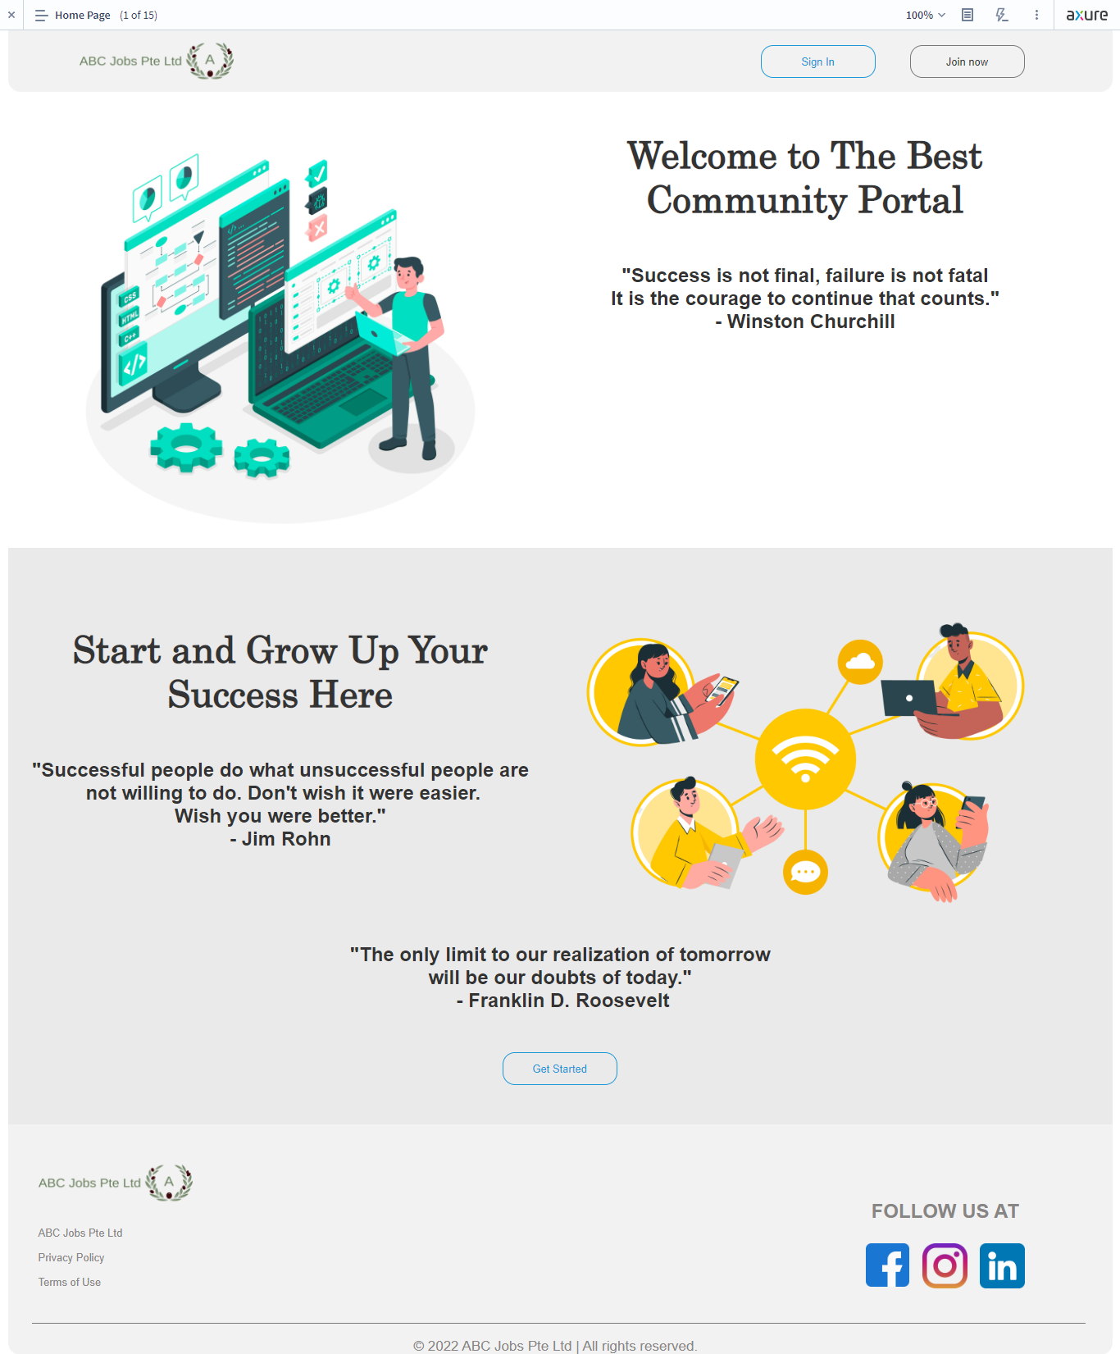
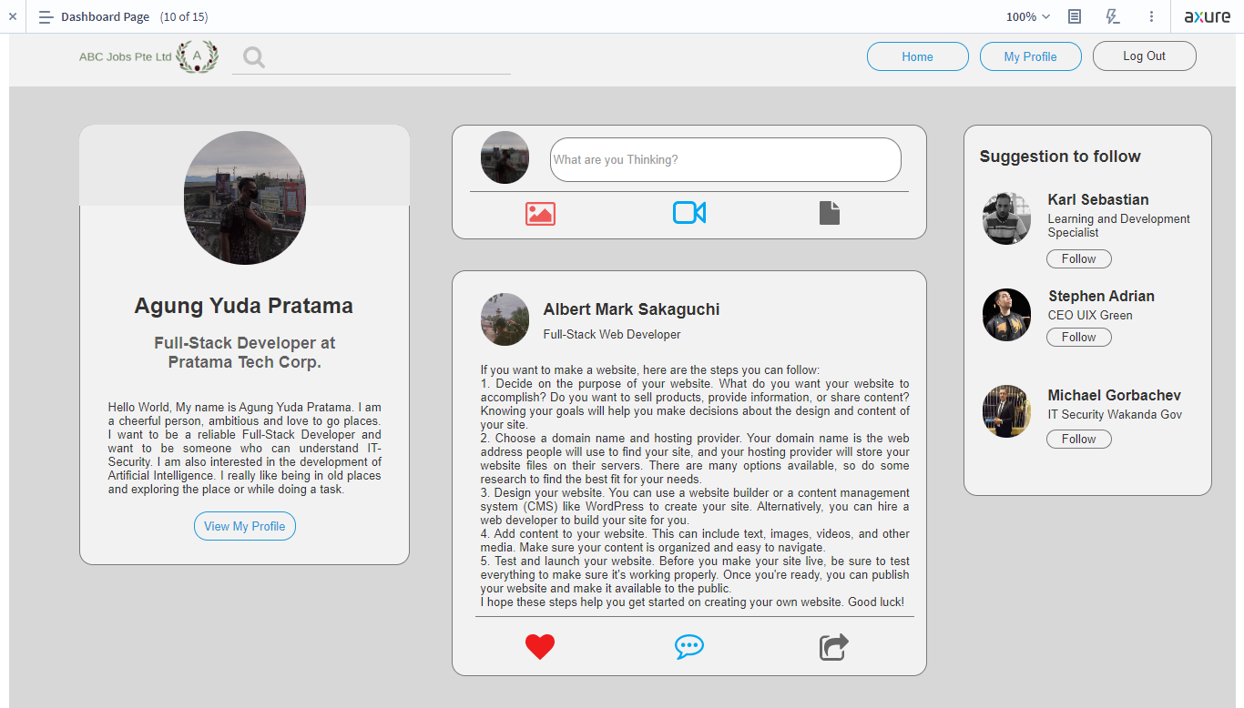
10. UI Design
Landing Page
Dashboard User

Slide 20
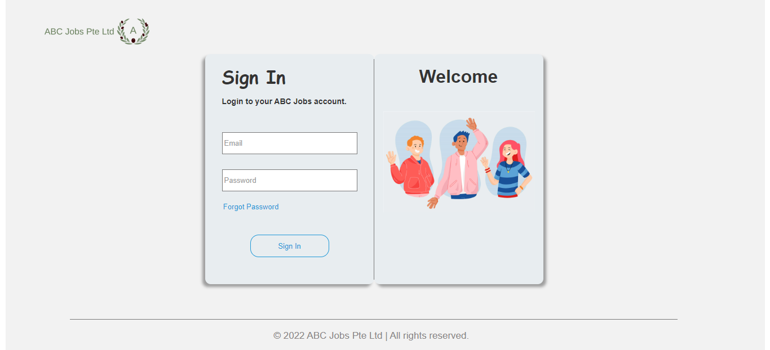
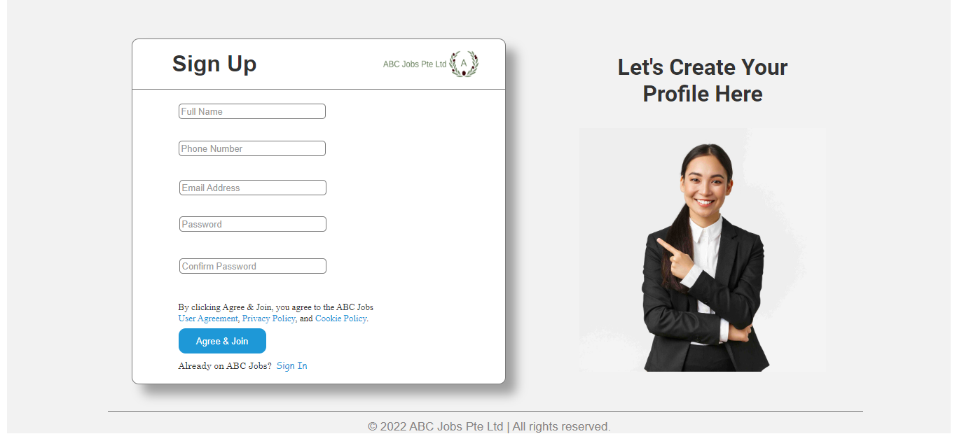
10. UI Design
SignIn Page
SignUp Page

Slide 21
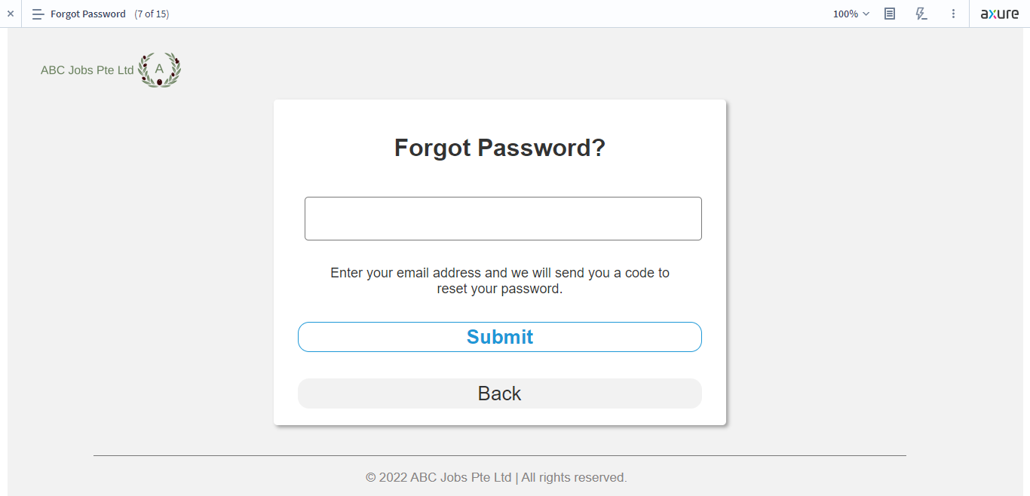
10. UI Design
Forgot Password Page

Slide 22
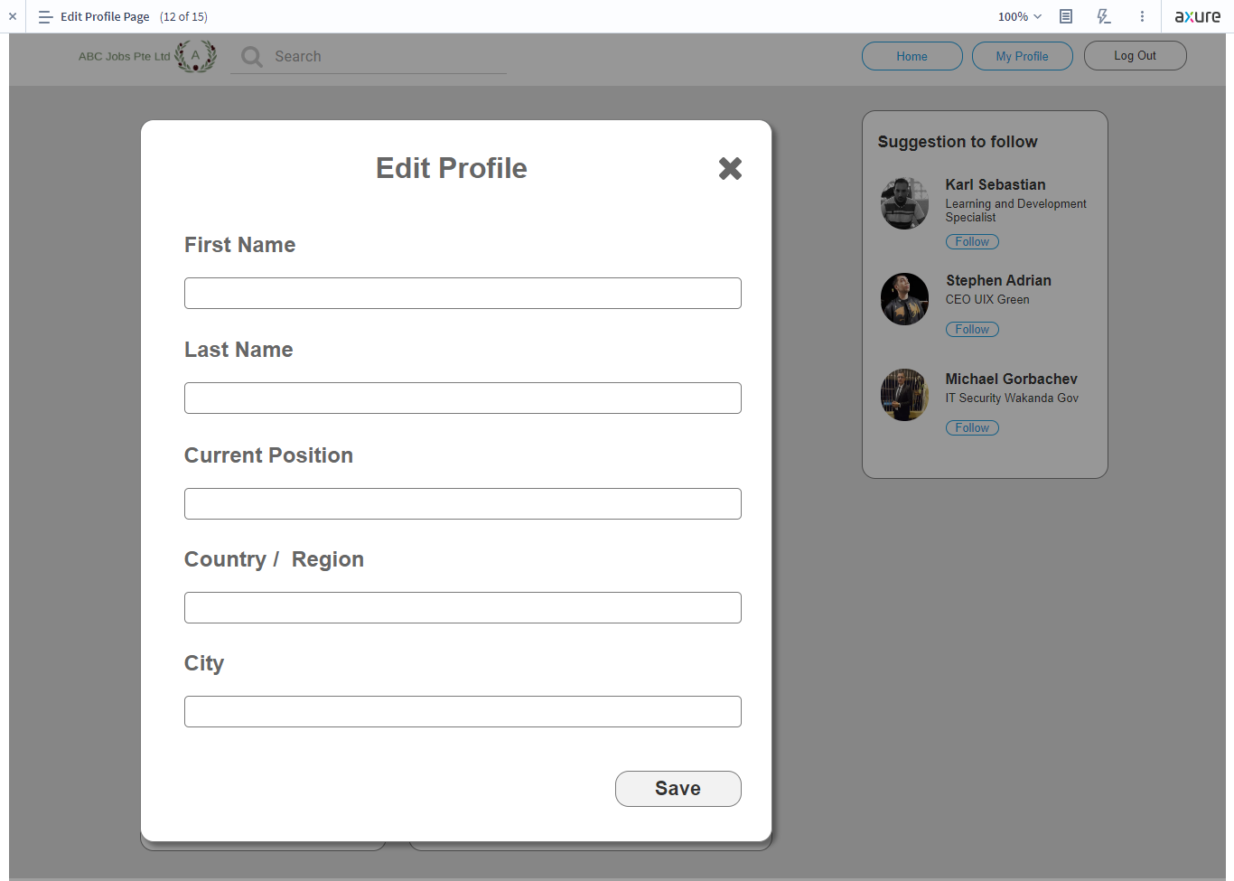
10. UI Design
Edit Profile Page

Slide 23
11. Spring Frameworks
Java Spring Includes
S. No. | Include | Purpose of Include
1 | Spring Core | This module offers numerous functionalities for developing JEE applications, including dependency injection and management beans.
2 | Spring data | Provide a collection of APIs that simplify working with various data storage, including relational databases and NoSQL databases.
3 | Spring MVC | This module is the implementation of Model View, and Controller

Slide 24
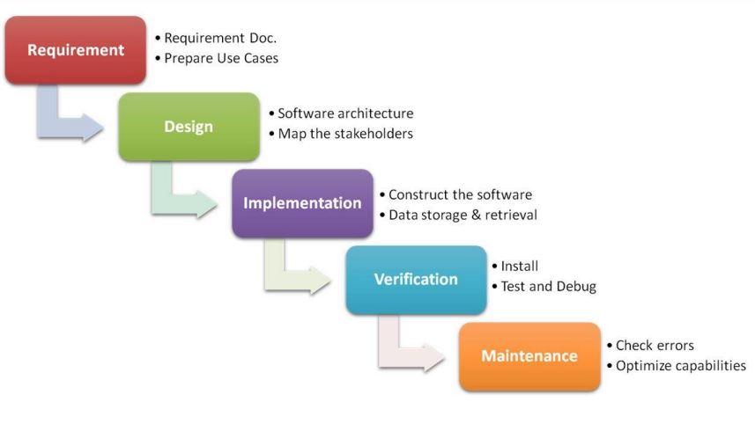
12. Software Development Methodology
Software Development Methodology being used
Since this project is using a waterfall paradigm, which employs a sequential and linear approach, each phase must be finished before moving on to the next. Programmers may easily control the development process by adopting this model. The phases of this paradigm are requirement collection, design, implementation, testing, and maintenance, each of which depends on the results of the one before it.

Slide 25
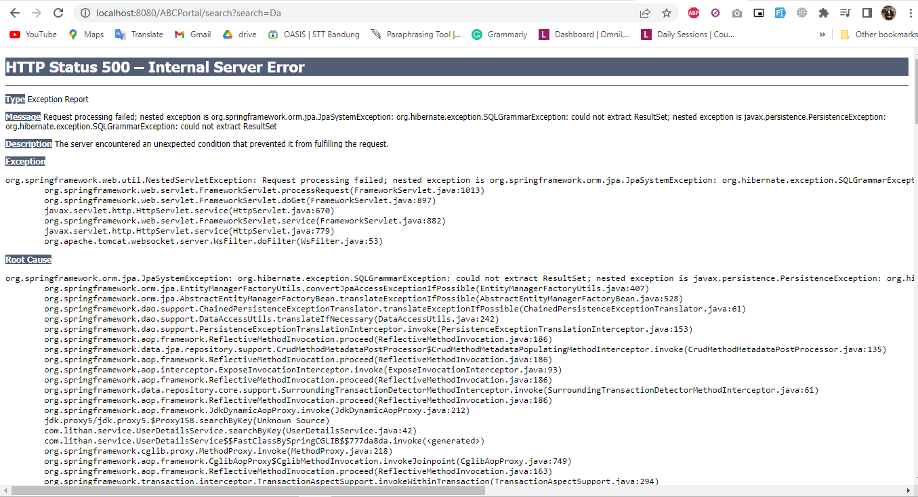
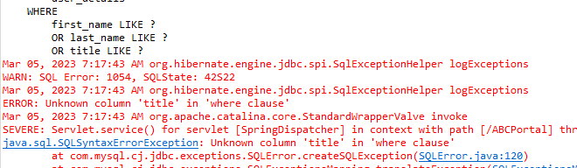
14. Application Screen Shots
Look in the repository
Concern in the search method
Do you have a title or not, if not change with other data that you have like a city or a phone number

Slide 26
15. Project Milestones & Tasks
Project Task ID | Project Task Description | Project Milestone ID
1 | Setup the Development Environment based on the Technical Development Environment | 1
2 | Power point Detailing the Business Process in the Proposed Application | 1
3 | Project Report detailing the Technical Design | 1
4 | Power Point Detailing the Project Plan | 1
5 | Develop the UI HTML standard pages (Based on Module 3 work) | 2
6 | Create common Spring Includes, Models, Views & Controllers | 2
7 | Develop Classes | 2
8 | Develop Spring Application | 2

Slide 27
16. Project Milestones & Tasks
Project Task ID | Project Task Description | Project Milestone ID
9 | Develop Test Cases | 3
10 | Develop Project Documentation | 3
11 | Develop User Manual | 3

Slide 28
17. Milestone Feedback & Action taken
Project Milestone ID | Milestone Feedback received from Tutor / Learning Facilitator | Action Taken (Yes / No)
1 | Problem faced during | Yes
2
3

Slide 29
18. Modifications Made based On Feedback

Slide 30
19. Project Results
List of Pages

Slide 31
19. Project Results
List of Pages

Slide 32
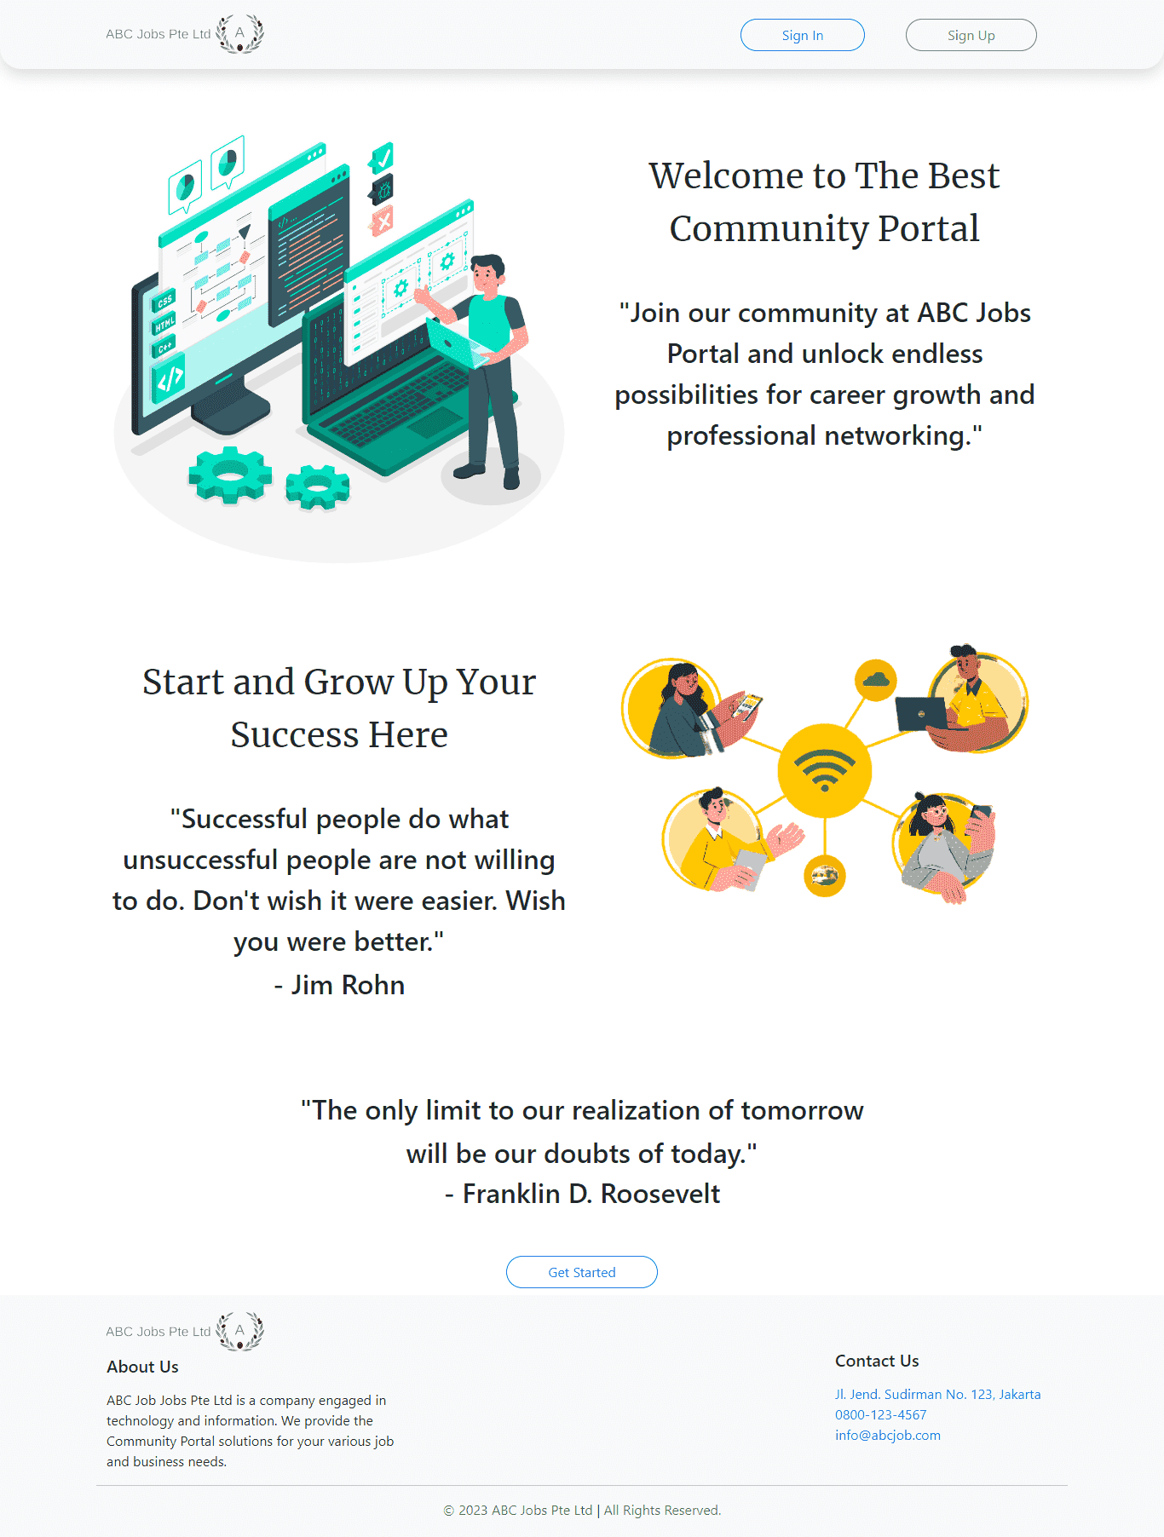
19. Project Results
Landing Page

Slide 33
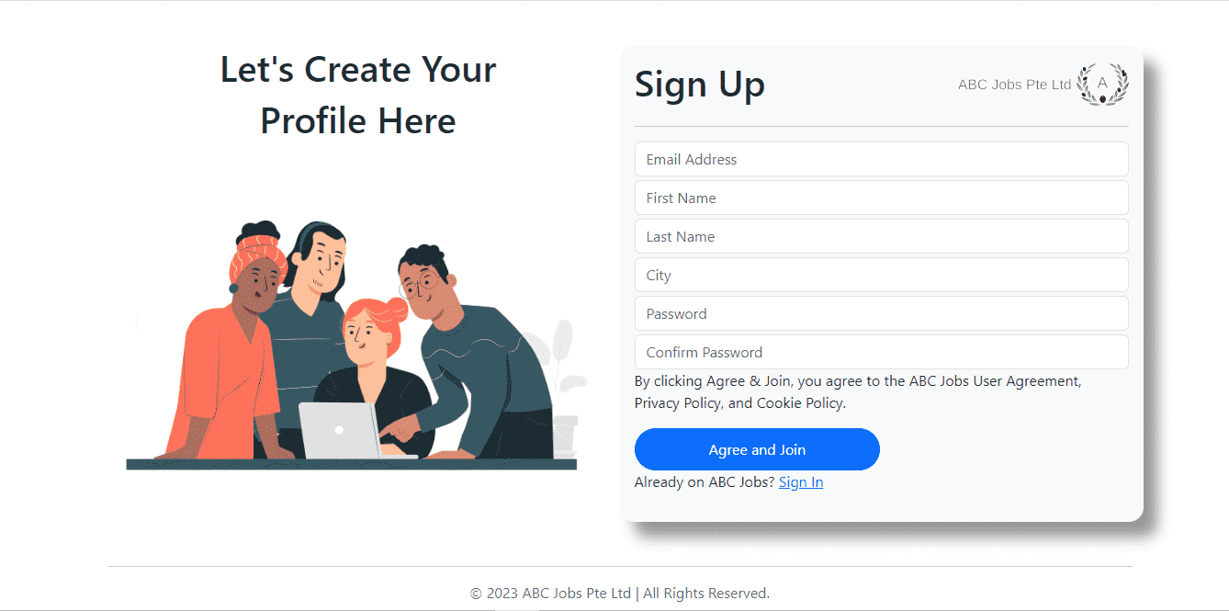
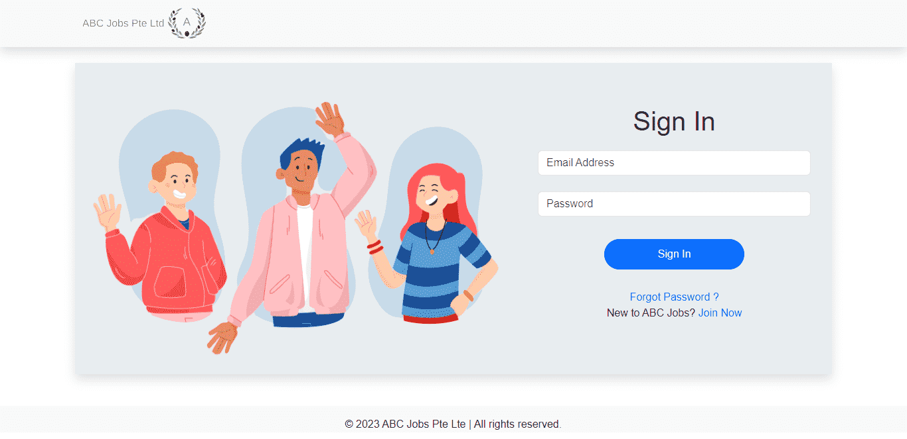
19. Project Results
Registration Page
Login Page

Slide 34
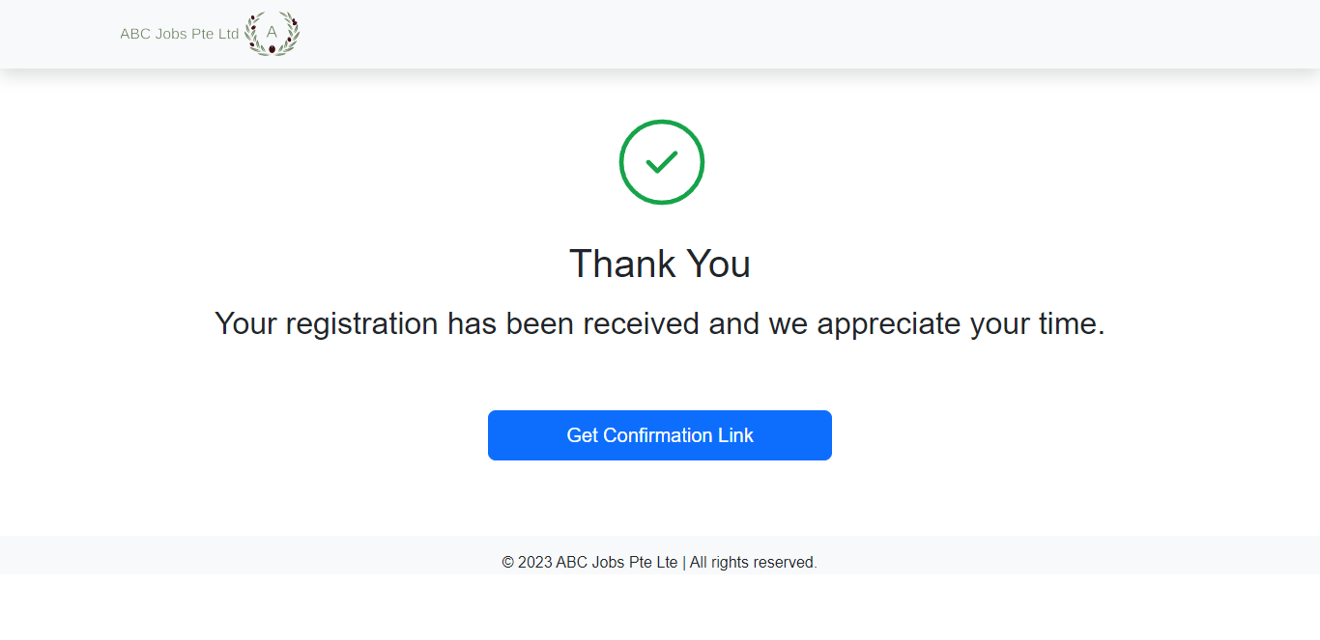
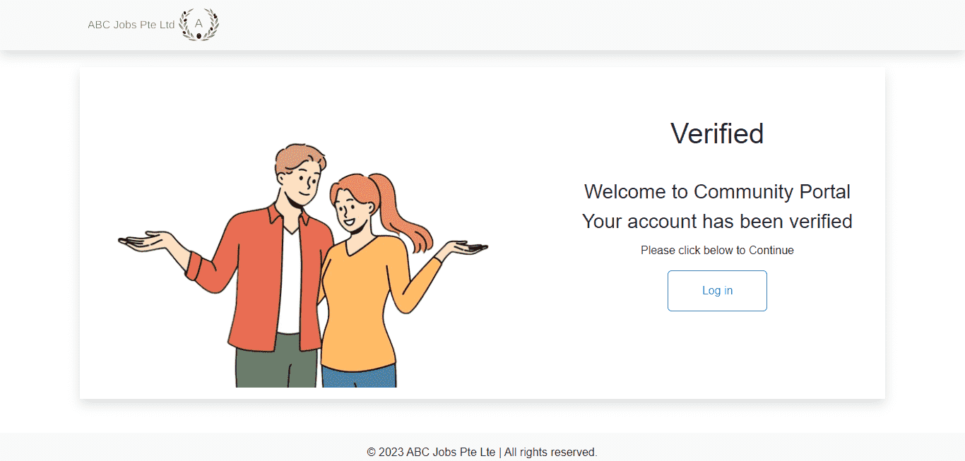
19. Project Results
Thank you Page
Verified Page

Slide 35
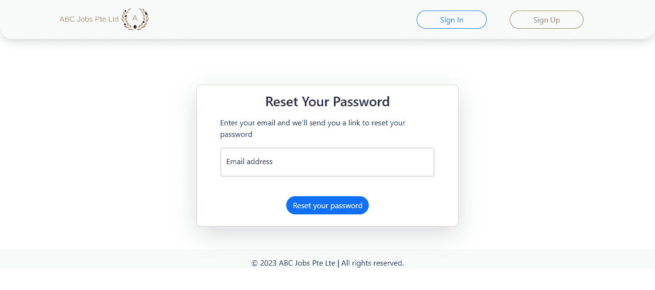
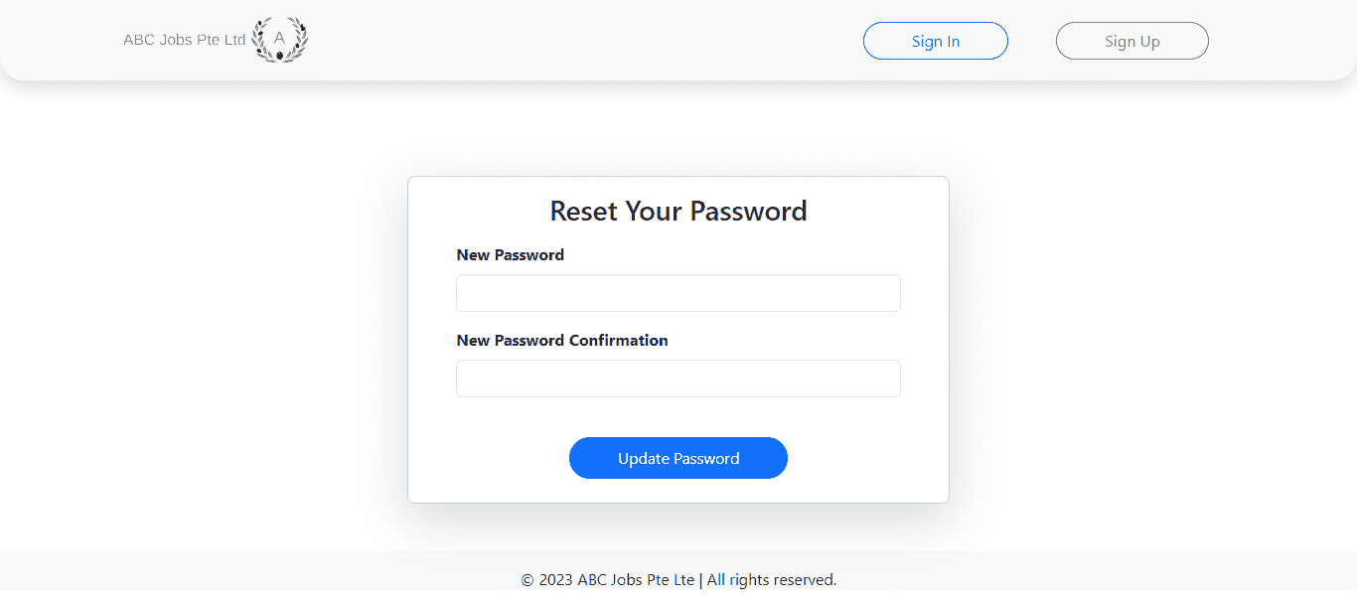
19. Project Results
Forgot Password

Slide 36
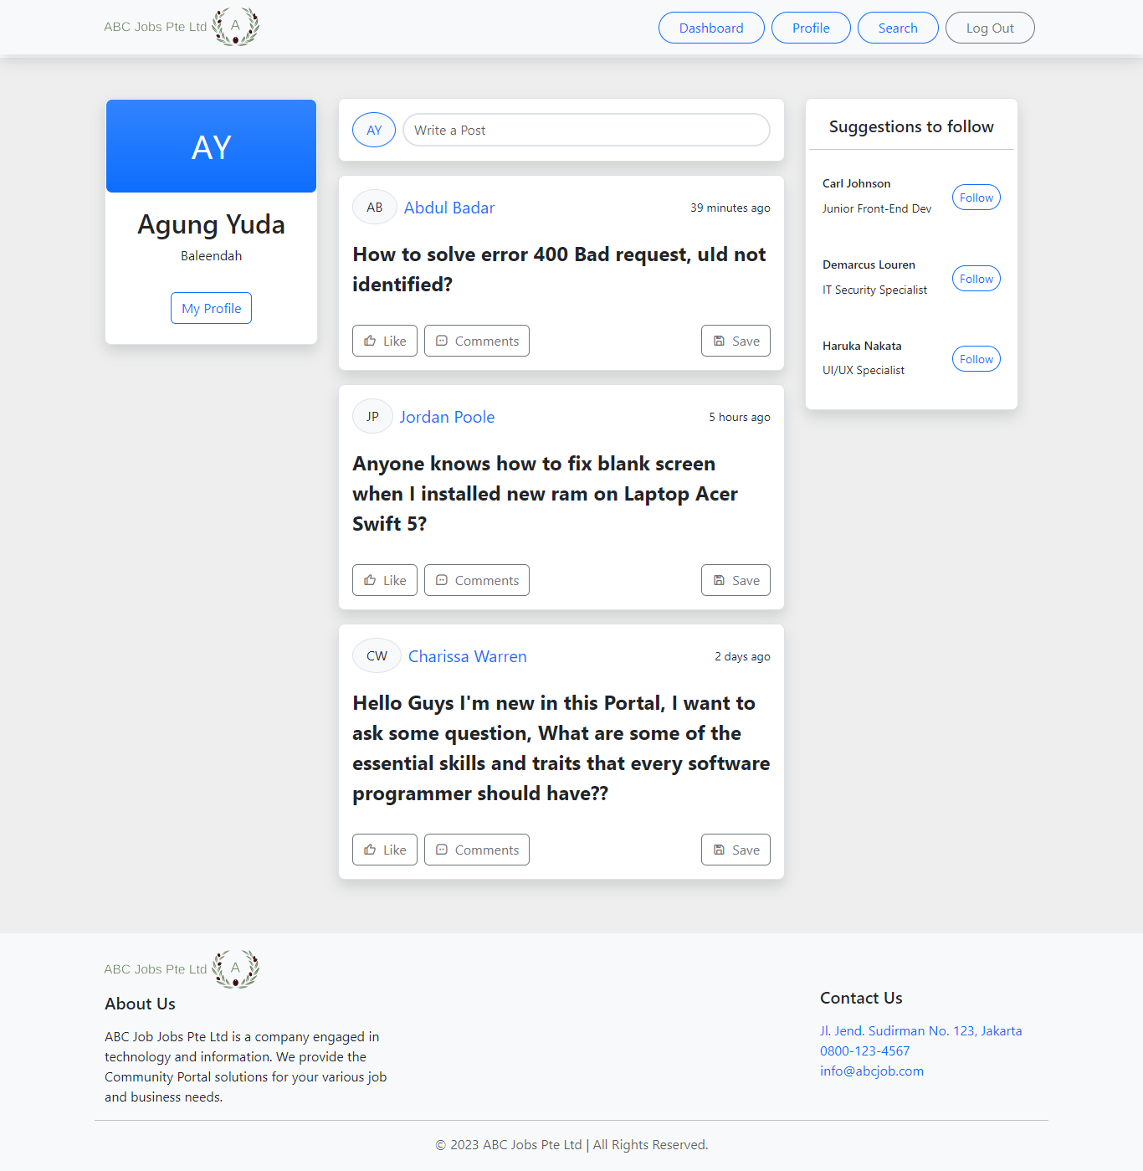
19. Project Results
Dashboard User

Slide 37
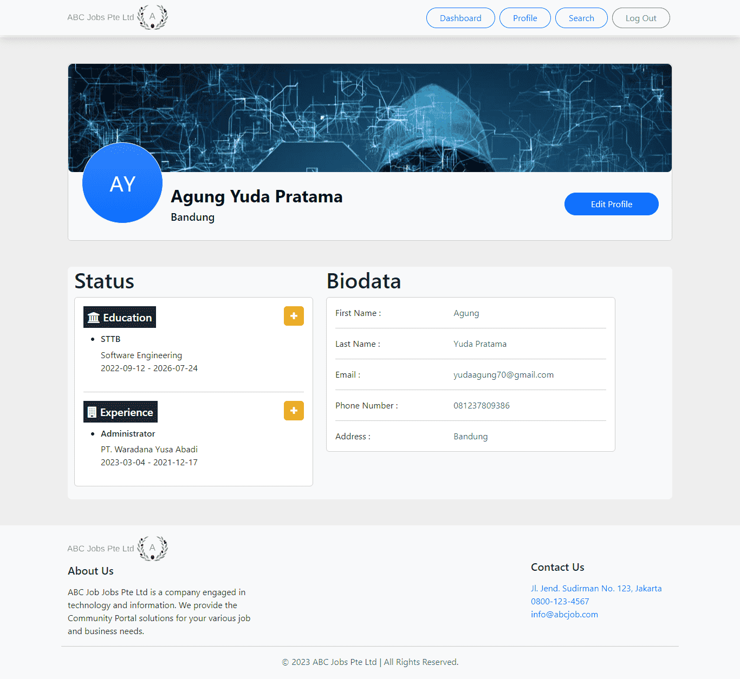
19. Project Results
Profile User

Slide 38
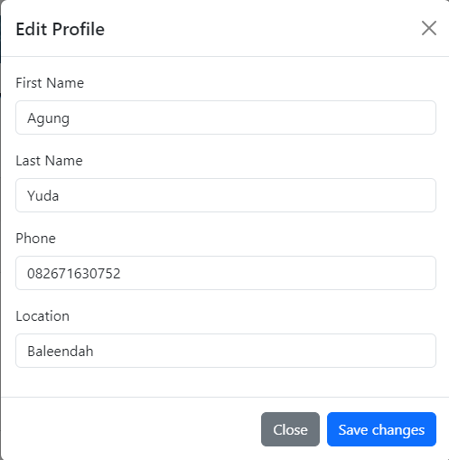
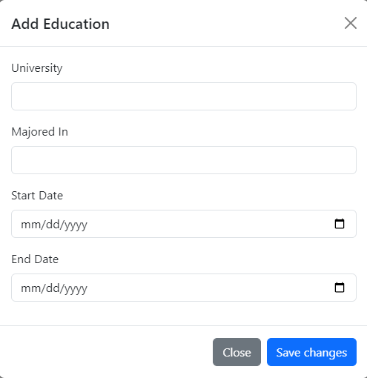
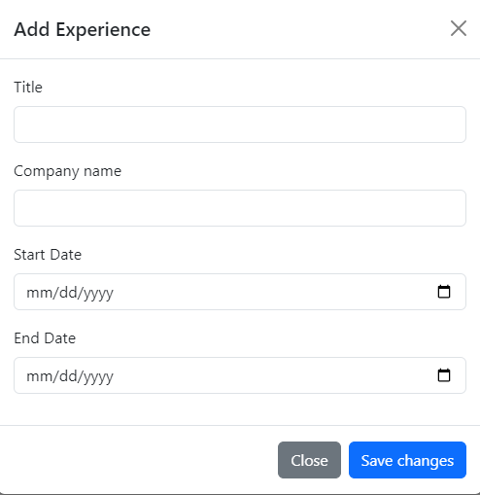
19. Project Results
Edit Profile User

Slide 39
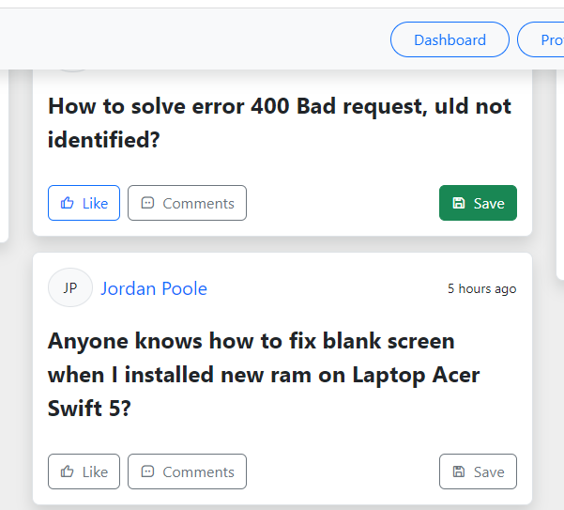
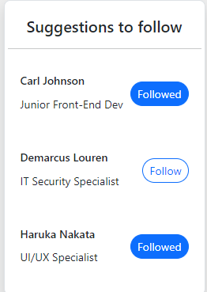
20. Proposed Improvements
List of Improvements
Button to like, comment and save
Button and suggestion to follow

Slide 40
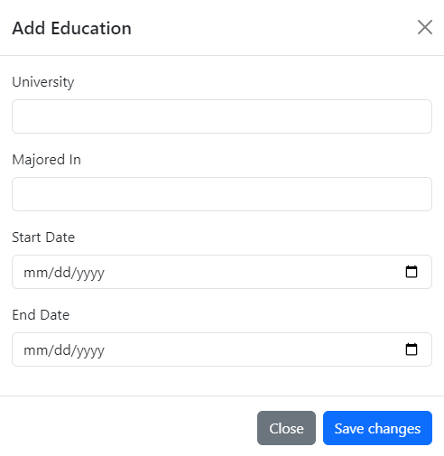
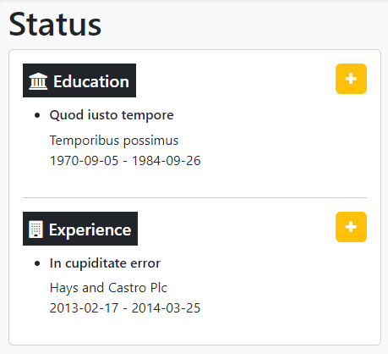
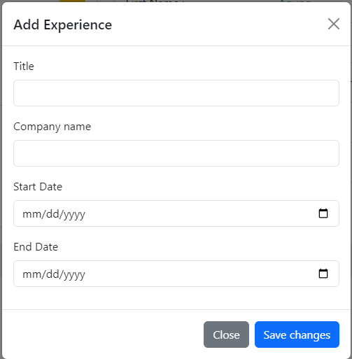
20. Proposed Improvements
List of Improvements
Add more detail about education.
Add more detail about experience

